Slide 1

www.studymafia.org
Seminar
On
Agile Methodology
Submitted To: Submitted By:
www.studymafia.org www.studymafia.org
Notes:
1
1

Slide 2

Agile Development
Agenda
Scope
Agile Development Foundations
Agile Processes
eXtreme Programming
Test-Driven Development
Case study – Galaxy
Experiences

Slide 3
Introduction
Agile software development methodology is an process for developing software (like other software development methodologies – Waterfall model, V-Model, Iterative model etc.)
However, Agile methodology differs significantly from other methodologies. In English, Agile means ‘ability to move quickly and easily’ and responding swiftly to change – this is a key aspect of Agile software development as well.

Slide 4
Agile Development
Scope :
Information sharing with respect to the Agile Development practices
A mapping between Agile Development and CMM process is yet to
be done
The mentioned case study is in the evaluation process with respect
to the Agile Methodology

Slide 5
Agile Development - Basics
Development Processes
A system reflects the principles and practices used in its construction
A process defines what activities are carried out, how they are done,
by whom and when
The amount of ceremony in a process varies from project to
project, company to company
Delivery of Value
Many projects fail to deliver value in either a timely fashion or at all
For both technical and non-technical reasons
Traditional development processes can be characterized as either...
Static, and therefore unresponsive, or...
Chaotic, and therefore unpredictable

Slide 6
A common situation in IT industry
Four Variables
The quantities that can be played with to affect delivery are...
Cost, i.e. throw more money at the problem
Time, i.e. push back the deadline
Quality, i.e. compromise the quality
Scope, i.e. reduce the scope of delivery
You get to chose one or more
1/4 or 2/4 or 3/4 or 4/4

Slide 7
Life cycle models
Linear Sequential Models
Waterfall
V-model
Prototyping Model
Evolutionary Software Process Models
Incremental
Spiral

Slide 8
Agile Development
Agility
Agile processes focus on the control and negotiation of scope
Streamlined processes that allows flexible response and development
Typically aimed at small to medium-size teams
Supports rapidly evolving or unclear requirements
Supports incremental delivery
Informal and Continuous Design
Design is not treated as a scheduled phase
Pragmatic rather than dogmatic use of tools and modeling notations
Favour rough up-front design (RUFD) over big up-front design (BUFD)
Software is supposed to be soft. Therefore, design to make this so
Agility : The gracefulness of a person that is quick and nimble
Pragmatic : Concerned with practical matters
Dogmatic : Characterized assertion of unproved or unprovable principles

Slide 9
Agile Development
Dependency Management
Isolate effect of changes
Encapsulation is concerned with the containment of design decisions
Partition to minimize dependencies
Low coupling between components
High cohesion within a component
Avoid cyclic dependencies
Minimalism
Less code, more software
The measure of software is in its utility not in the quantity of its
source code
Omit needless code

Slide 10
Agile Development
Remove to Improve
Aim to remove unnecessary or confusing aspects of the software
The less code you have, the less you have to fix, debug, optimise, etc.
Do so iteratively and decrementally
Removing and reshaping are part of the process

Slide 11
Agile Development
Iterative and Incremental
Iterative and incremental development offer a framework in which a system
can grow
Accommodates change and inspiration
Offers time for building and testing
Empirically based
Tests assumptions as well as code
Accepts that change happens

Slide 12
Agile Development
MacroProcess
Requirements
MicroProcess
Increment
Analysis
Prototyping
Simple design
Refactoring
Testing

Slide 13
Agile Development
Stable Intermediate Forms
Changes are small, stable, and either...
Architectural modifications that preserve existing functionality,
i.e. a refactoring, or...
Functionality extensions that do not affect existing architecture
Changes are isolated and can be taken gradually
Can be paused, rolled back, etc.

Slide 14
Agile Development
The Agile Manifesto
Putting people into the process, rather than the process into people
Reaction to bureaucratic development methods
We have come to value:
Individuals and interactions over process and tools
Working software over comprehensive documentation
Customer collaboration over contract negotiation
Responding to change over following a plan
That is, while there is value in the items on the right, we value the items on the left more. Manifesto for Agile Software Development

Slide 15
Agile Development
Agile Processes
XP and TDD (code and test centric practices)
RUP-lite and dX
Scrum (management practices)
FDD (Feature Driven Development)
DSDM (Dynamic System Development Method)

Slide 16
Agile Development
eXtreme Programming
XP is perhaps the most widely recognised agile development method
Based on taking successful development practices
Covers both code and business perspectives
Agile methods considered to be code-centric, but most do not
offer code-level practices
XP Values
At the heart of XP are five values...
Communication
Simplicity
Feedback
Courage
Respect

Slide 17
Agile Development
Sit together
Whole team
Informative workspace
XP Primary Practices
XP is based on thirteen primary practices
Each individually makes sense on its own...
But they work together to reinforce one
another
XP is therefore a highly disciplined approach
Energized work
Pair programming
Stories
Weekly cycle
Quarterly cycle
Slack
Ten-minute build
Continuous integration
Test-Driven Programming
Incremental Design

Slide 18
Agile Development
Real customer involvement
XP Corollary Practices
The eleven corollary XP practices supplement the primary practices
Some are more speculative than the primary practices
The primary practices should be in place before the corollary ones
Incremental deployment
Team continuity
Shrinking teams
Root-cause analysis
Shared code
Code and tests
Single code base
Daily deployment
Negotiated scope contract
Pay-per-use

Slide 19
Agile Development : What XP is Not
Adoption of XP is based on practices not on aping surface phenomena
E.g. avoiding comments or documentation does not mean that
you are doing XP!
Core practices must be in place
E.g. cannot be XP if there is no refactoring, testing, pairing or
continuous integration

Slide 20
Agile Development : Test-Driven Development
TDD has emerged from the many practices that form the core of
Extreme Programming
The code-centric practices in the micro-process rather than
driving the macro-process
TDD brings testing to the fore of development rather than the aft

Slide 21
Agile Development : TDD
Build Practices
Essential Practices
Fine grained versioning
Continuous integration
Example based test cases
Defined stable increments
Active test writing
Sufficient Design
Refactoring
Team Practices
Automated Unit Testing
Pair Programming
Shared Coding Guidelines

Slide 22
Agile Development : SCRUM
Based on the empirical process control model, Scrum is...
A set of management practices focused on iterations (sprints)...
With continuous daily feedback (scrums)
Traditional development activities may be mapped to individual sprints
SCRUM : (rugby) the method of beginning play in which the forwards of each team crouch side by side with locked arms; play starts when the ball thrown in between them and the two sides compete for possession

Slide 23
Agile Development : SCRUM Process
30-day sprints...
Uninterruptible goal-oriented iteration
Product backlog holds customer prioritised features, which are
assigned to a sprint backlog
Daily scrum...
15 minute stand-up meeting
Individual progress, obstacles and intended progress before next
scrum

Slide 24
Agile Development : Combining Scrum with TDD
Scrum provides a mature agile management mechanism and
framework
However, it does not define the technical practices, as found in XP
and TDD
Scrum can be enhanced with code-centric practices as found in TDD
And further complemented with team practices, such as pair
programming

Slide 25
Agile Development : XP Practices
Sit Together
Separating team members reduces the communication between them
Disruption occurs whether the separation is across a single building or
across continents
Therefore, try to find a single workspace where the team can be
gathered to work Line-of-sight contact
Whole Team
A team needs to be cross functional Containing all the skills and
perspectives needed for effective project execution
There are many technical roles on a team
System testers
Interaction designers
Architects
Programmers

Slide 26
Agile Development
Energized Work
Anything much over a 40-hour week is often solving the wrong problem. No more than one week at a time on overtime
Studies do not show that overtime is good for productivity and quality. Which means that such time is typically a waste, not an investment
Informative Workspace
The workspace should reflect the work and state of the project
As opposed to neutral, uniform with respect to other offices in the
same building or company
Allows more visual and physical feedback of targets, metric,
progress, priorities, etc

Slide 27
Agile Development
Pair Programming
The full practice is for all production code to be produced by a pair
of programmers
Participative design and design sharing
Acts as a continuous code and design review
Smoothes the peaks and troughs of personal productivity
Makes development a dialogue
User Stories
Business people decide scope and priority
User stories describe usage scenarios
Which user stories should be addressed in the next release?
Technical people estimate the associated programming tasks
Past record is used to establish development 'velocity'

Slide 28
Agile Development
Weekly and Quarterly Cycles
Tangible short-term goals are easier to score than ambitious long-
term ones
Complete an iteration and produce a stable increment each
week
Use three months as the longer-term horizon for planning and
retrospection
Slack
Slack defines the freedom to adapt
Plans should be sufficient, but not rigid
Slack is about the ability to respond to change
Slack does not imply lazy or inefficient
An overloaded schedule is gridlocked, a prioritised schedule
with space is responsive
Slack at all levels is necessary to make the organization work effectively and to grow. It is the lubricant of change. Tom DeMarco

Slide 29
Agile Development
Ten-Minute Build
Ideally, it should be possible to build a system and run all the
tests in ten minutes
This is a matter of architecture, reducing dependencies...
And technology, tuning the build technology — software and
hardware — as necessary
Continuous Integration
Continuous integration ensures that system is always in a known
and stable state
Automatic and many times per day
Successful integration is based on scenario driven acceptance
tests

Slide 30
Agile Development
Test-First Programming
XP unit-testing and coding practice is based on writing the
tests before the code
Unit testing for all production code
Acceptance test of whole system for integration and release
Testing is integrated into the lifecycle
Continuous testing gives immediate feedback
Incremental Design
Design for today
Do not try to predict the future
A design is always effective and working at a given point in time,
but evolves over time
What works is defined by tests code must pass
To achieve simplicity paradoxically requires an enormous amount of effort. John Pawson

Slide 31
Agile Development
A Better Practice and Philosophy
Testing can only prove the presence of bugs, not their absence
Testing is therefore about building confidence
Testing is a part of development, not something that follows it
as an extra
Test Early. Test Often. Test Automatically.
Andrew Hunt and David Thomas

Slide 32
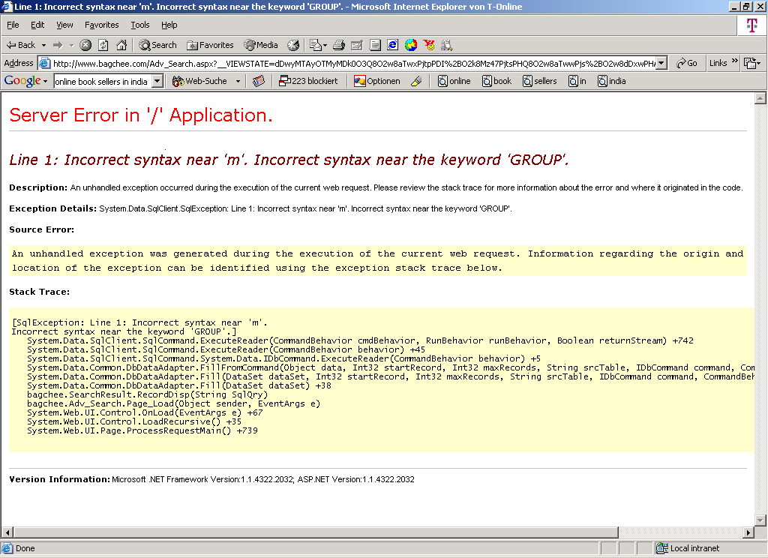
Agile Development

Slide 33
Agile Development
Driver Rather than Passenger
Test-driven development is based on writing tests with the code
Unit testing for all production code
Acceptance testing of whole system for integration and release
Integrated into the lifecycle
Continuous testing gives immediate feedback
Refactoring
Refactoring is personal hygiene for software
Ensures that design is clean and sufficient
Also acts as an active form of code review
Predicated on the existence of unit tests
Refactoring (noun): a change made to the internal structure of software to make it easier to understand and cheaper to modify without changing its observable behavior.
Refactor (verb): to restructure software by applying a series of refactorings without changing the observable behavior of the software. Martin Fowler

Slide 34
Agile Development : Stakeholder perspective
Domain/Business Developers
Easy to understand documentation of usecases and stories
Users prioritize the features to be released
(Not the customer co-ordinator)
Intermediate releases makes the customers confident on the progress
Fast and Intermediate releases enables a faster feedback (/month)
“I know what I am going to get and I have a say”

Slide 35
Agile Development : Stakeholder perspective
Application/Tool Developers
Very less rework due to changes in requirements
Less number of bugs and unexpected behavior of system is removed
Interaction with customer and regular meetings helps in individual identity
Separate plan for the Integration tests is not required
Developer knows what “End User” wants
More work satisfaction as each “feature” provided is used by “End User”
With daily sprints, all issues are resolved with minimum turn around time
Delivery pressure on the developer in each month
In the Initial stages daily sprints makes developer little bit insecure
Difficult for the team which believes in the conventional methods

Slide 36
Agile Development : Stakeholder perspective
Management
Changes in Requirements and Design causes less rework
Cost of Quality (COQ) is less
No additional costs for integration tests
No feature is developed unless requested by end-user
Going Agile does not mean teams are revolutionary
Going Agile does not mean Customer is involved all the time

Slide 37
Agile Development : Stakeholder perspective
Customer Transparency
JIRA tool used for the task entry and tracking both by DevTeam and Customer
Customer has a overview of team members load and
„Who is doing what“
JIRA is also attached to the CVS repository, to track the changes
Everyday telecons with customer, clarifies day-to-day issues
- No delay in clarifications
Productive system is obtained at each nightly builds
Integration testing is not a separate process - (Eclipse & CVS)
Acceptance testing is not a huge process

Slide 38
Agile Development
User Stories (from end users):
What do you want
What do you feel about the current process (if any)
How will you benefit by this
Whats the priority of this feature
Usecases and Sequence Diagrams :
Describe all the user stories in a diagrammatic representation
Usecases makes sense to users and application developers
Flow of the user interactions is described as a Sequence
User and developer has a complete understanding of the system

Slide 39
Agile Development
Requirements
A top level feature list is maintained
Usecases forms the basis for the development
Design
Design in small iterations, BUT have a complete overview of system
Refactor the design, BUT don’t change the design
Design by contract, BUT make sure that you agree to it
Coding
Source code is maintained in the CVS repository
Everyday developer synchronizes the repository – Integration Tests
Everyday a new/small functionality is checked-in
Everyday while synchronizing the repository, code review is done
and directly informed to team members
Refactor the code regularly to make it clean – DON’T change the
functionality

Slide 40
Agile Development
Unit Tests
Every core function has a JUnit test written
Every module has a test suite that has number of test cases
The entire system put together also has a system test suite
Test suite is run daily and feedback is given to respective users
Testing is not a separate ceremony, its part of development
Integration Tests
No integration process - Covered as a part of the daily synchronization

Slide 41
Advantages of Agile Methodology
In Agile methodology the delivery of software is unremitting.
The customers are satisfied because after every Sprint working feature of the software is delivered to them.
Customers can have a look of the working feature which fulfilled their expectations.
If the customers has any feedback or any change in the feature then it can be accommodated in the current release of the product.
In Agile methodology the daily interactions are required between the business people and the developers.
In this methodology attention is paid to the good design of the product.
Changes in the requirements are accepted even in the later stages of the development.

Slide 42
Disadvantages of the Agile Methodology
In Agile methodology the documentation is less.
Sometimes in Agile methodology the requirement is not very clear hence it’s difficult to predict the expected result.
In few of the projects at the starting of the software development life cycle it’s difficult to estimate the actual effort required.
The projects following the Agile methodology may have to face some unknown risks which can affect the development of the project.

Slide 43
Conclusion
Presently, the agile methodology is more commonly used in the IT industry. As per the recent survey, the respondents of more than 50% companies practiced the Agile development. No matter what role it played in the industry, there is a need to understand its working and how it is different from other methods of software development.

Slide 44
References
www.google.com
www.wikipedia.com
www.studymafia.org
www.pptplanet.com

Slide 45
Thanks

